Slide 1



Analyzing Customer Churn in Power BI
View in Power BI

Slide 2
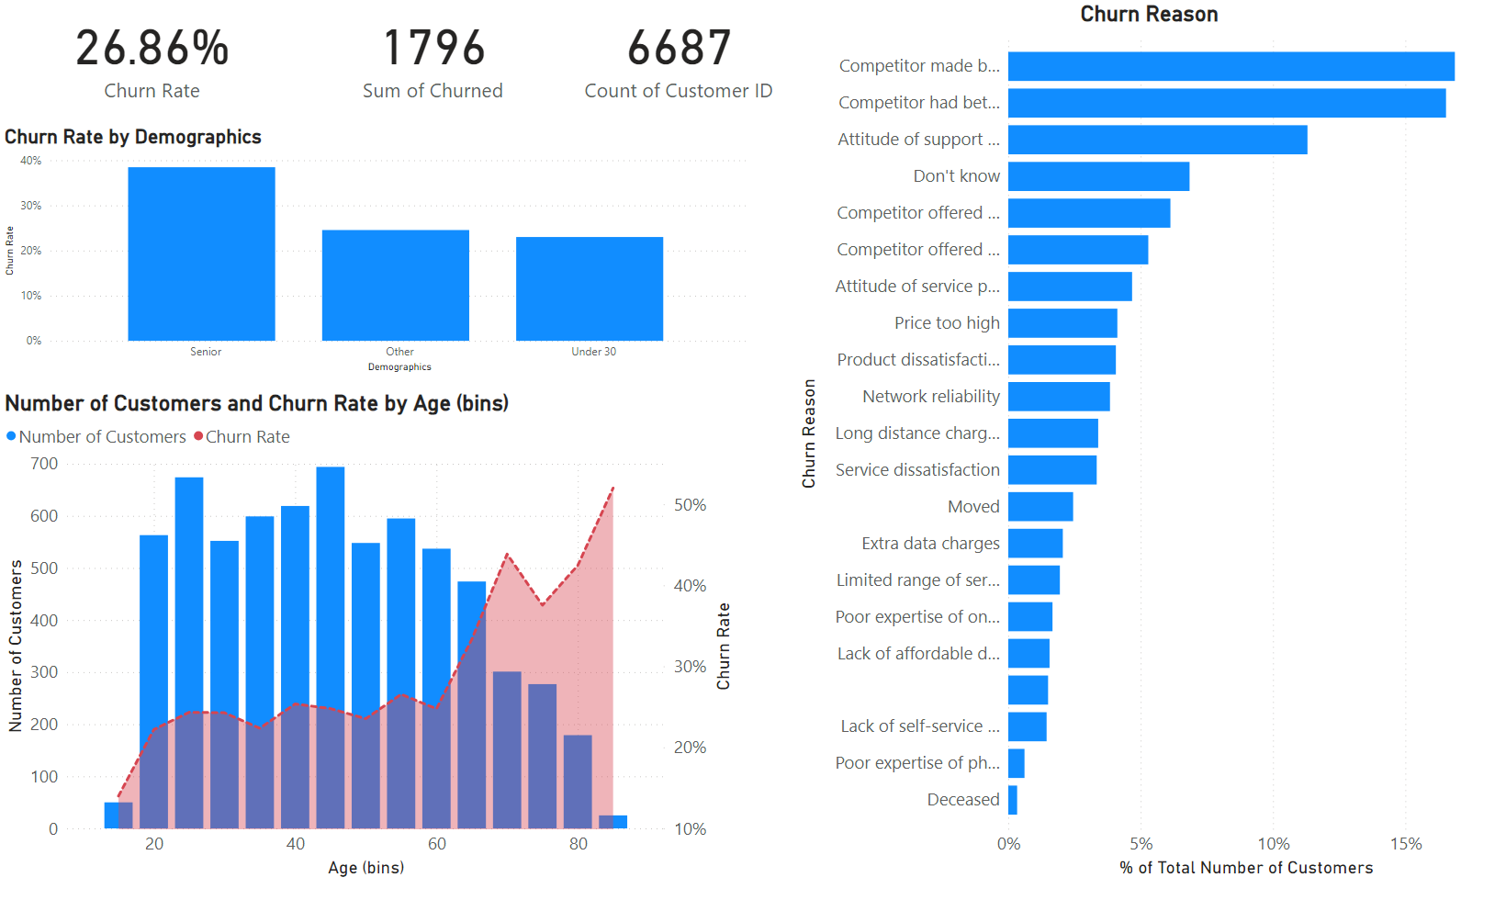
Churn Demographics
Notes:
card
No alt text provided
card
No alt text provided
card
No alt text provided
lineClusteredColumnComboChart
No alt text provided
Churn Reason
No alt text provided
clusteredColumnChart
No alt text provided

Slide 3
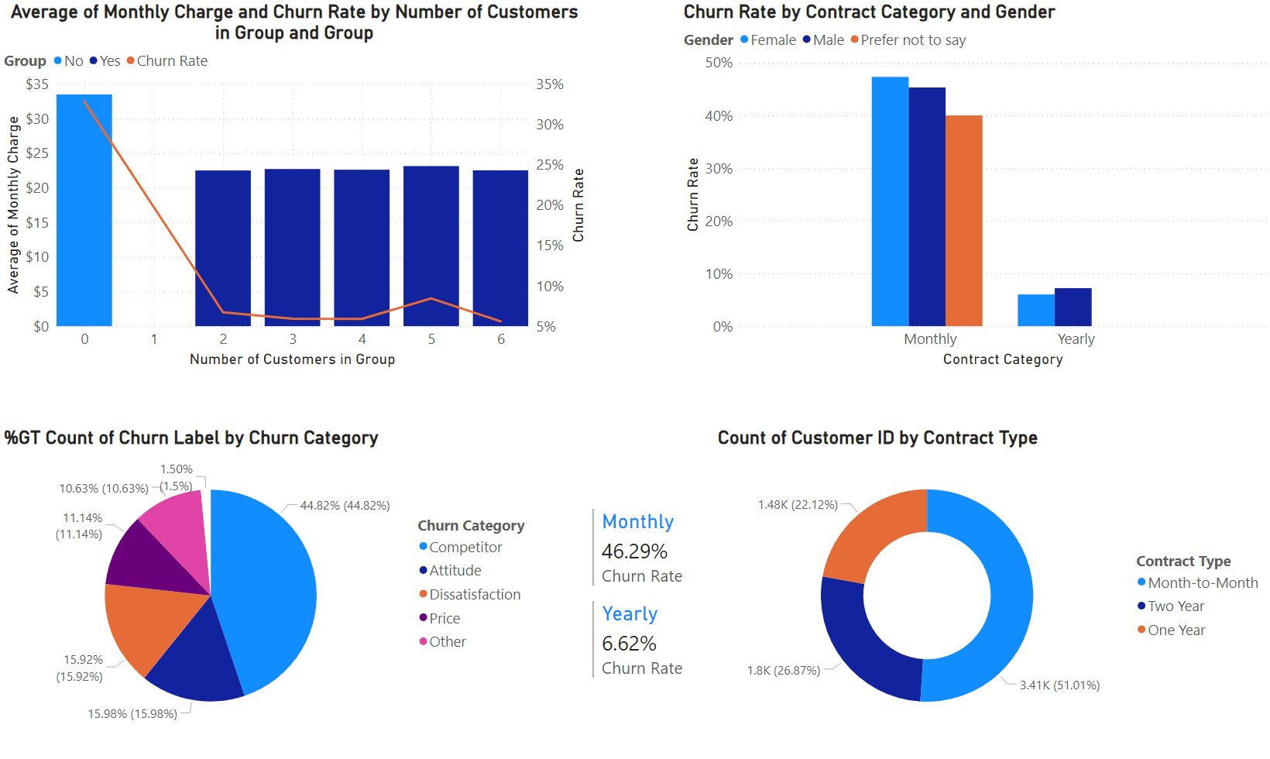
Groups and Categories
Notes:
lineStackedColumnComboChart
No alt text provided
clusteredColumnChart
No alt text provided
multiRowCard
No alt text provided
pieChart
No alt text provided
donutChart
No alt text provided

Slide 4
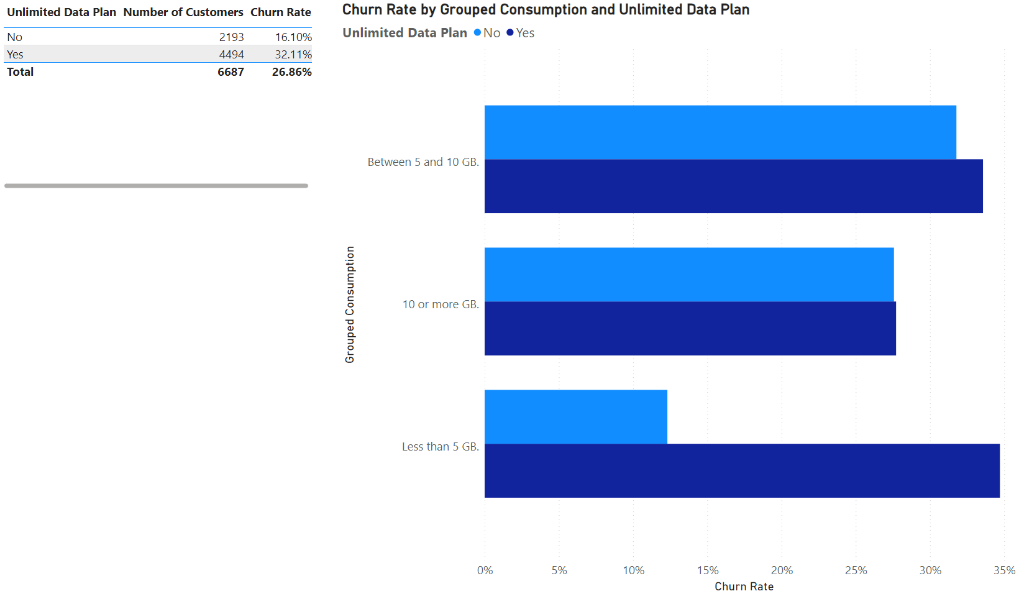
Unlimited plan
Notes:
tableEx
No alt text provided
clusteredBarChart
No alt text provided

Slide 5
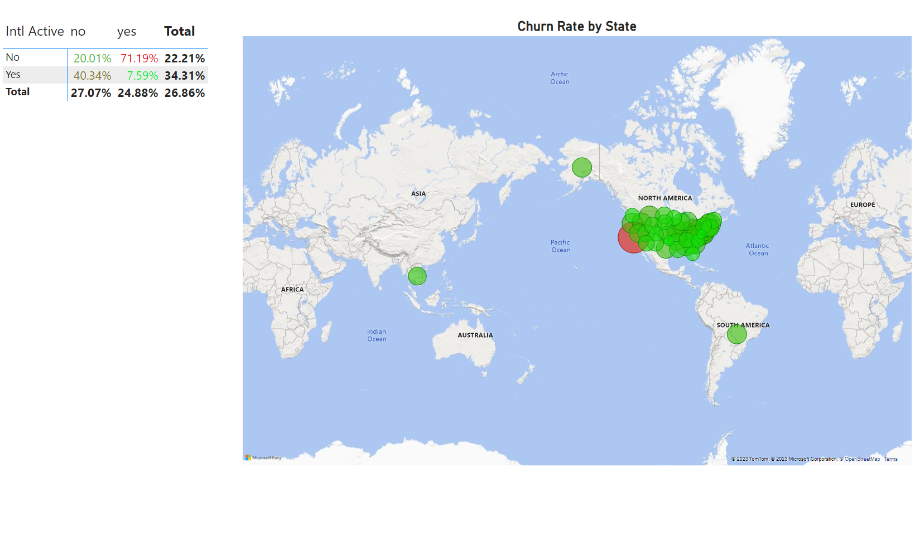
International Calls
Notes:
pivotTable
No alt text provided
map
No alt text provided

Slide 6
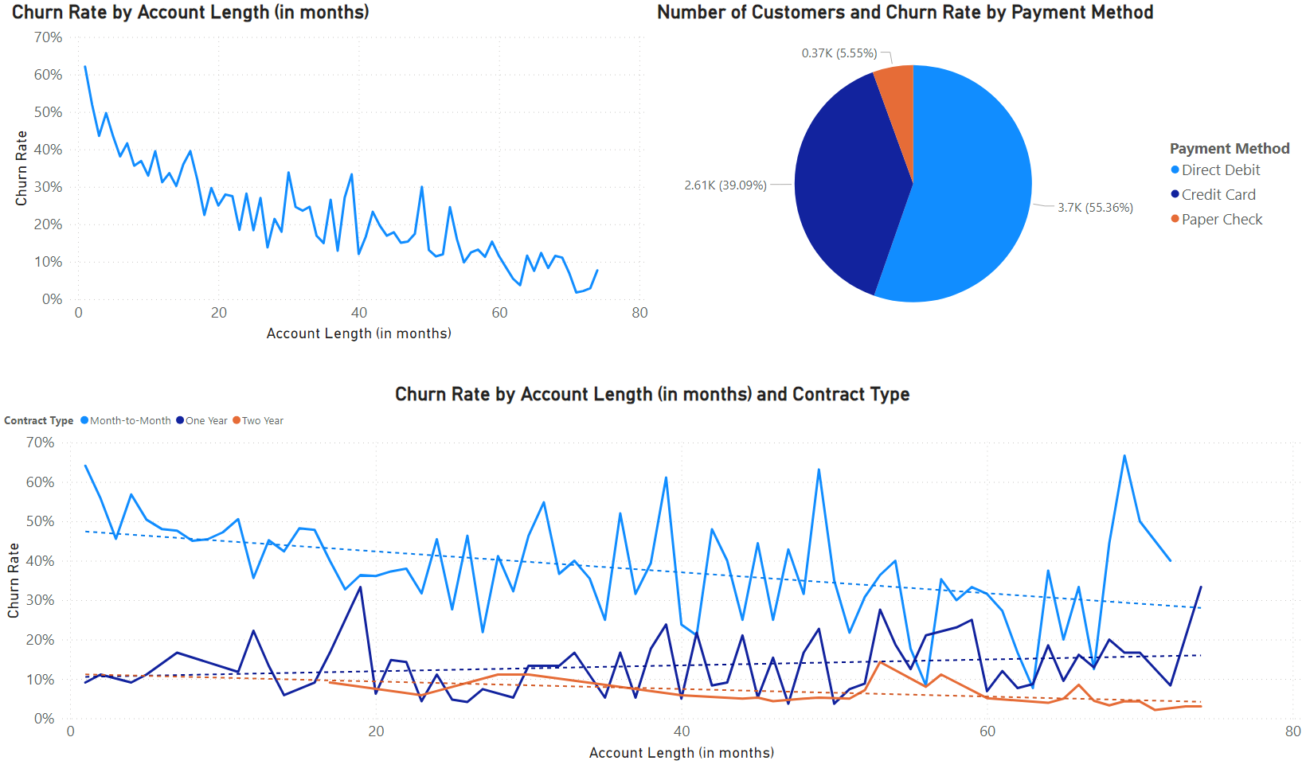
Contract type
Notes:
lineChart
No alt text provided
lineChart
No alt text provided
pieChart
No alt text provided

Slide 7
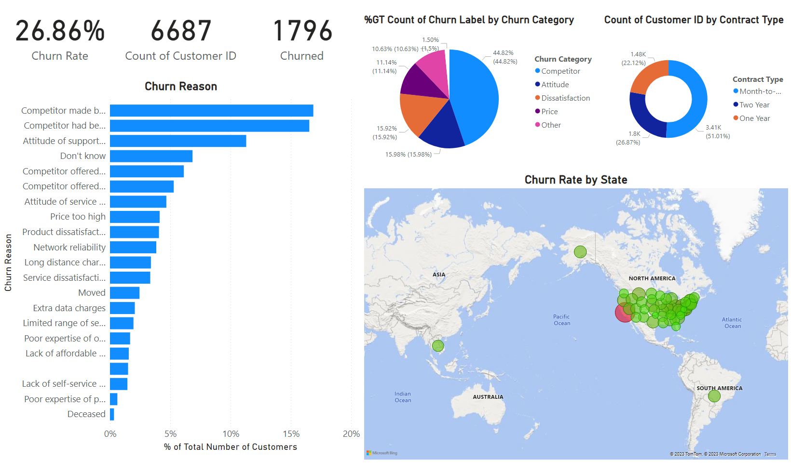
Overview
Notes:
card
No alt text provided
card
No alt text provided
Churn Reason
No alt text provided
pieChart
No alt text provided
donutChart
No alt text provided
map
No alt text provided
card
No alt text provided

Slide 8
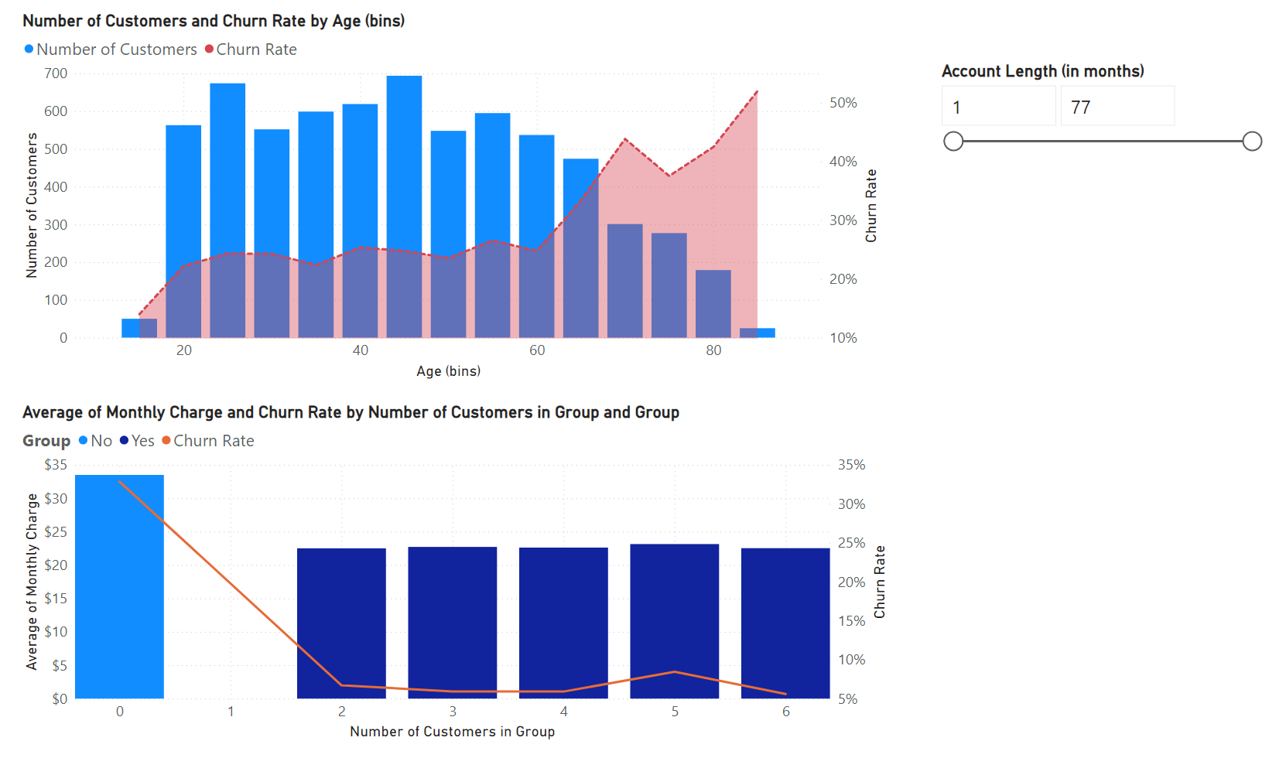
Age Groups
Notes:
lineClusteredColumnComboChart
No alt text provided
lineStackedColumnComboChart
No alt text provided
slicer
No alt text provided

Slide 9
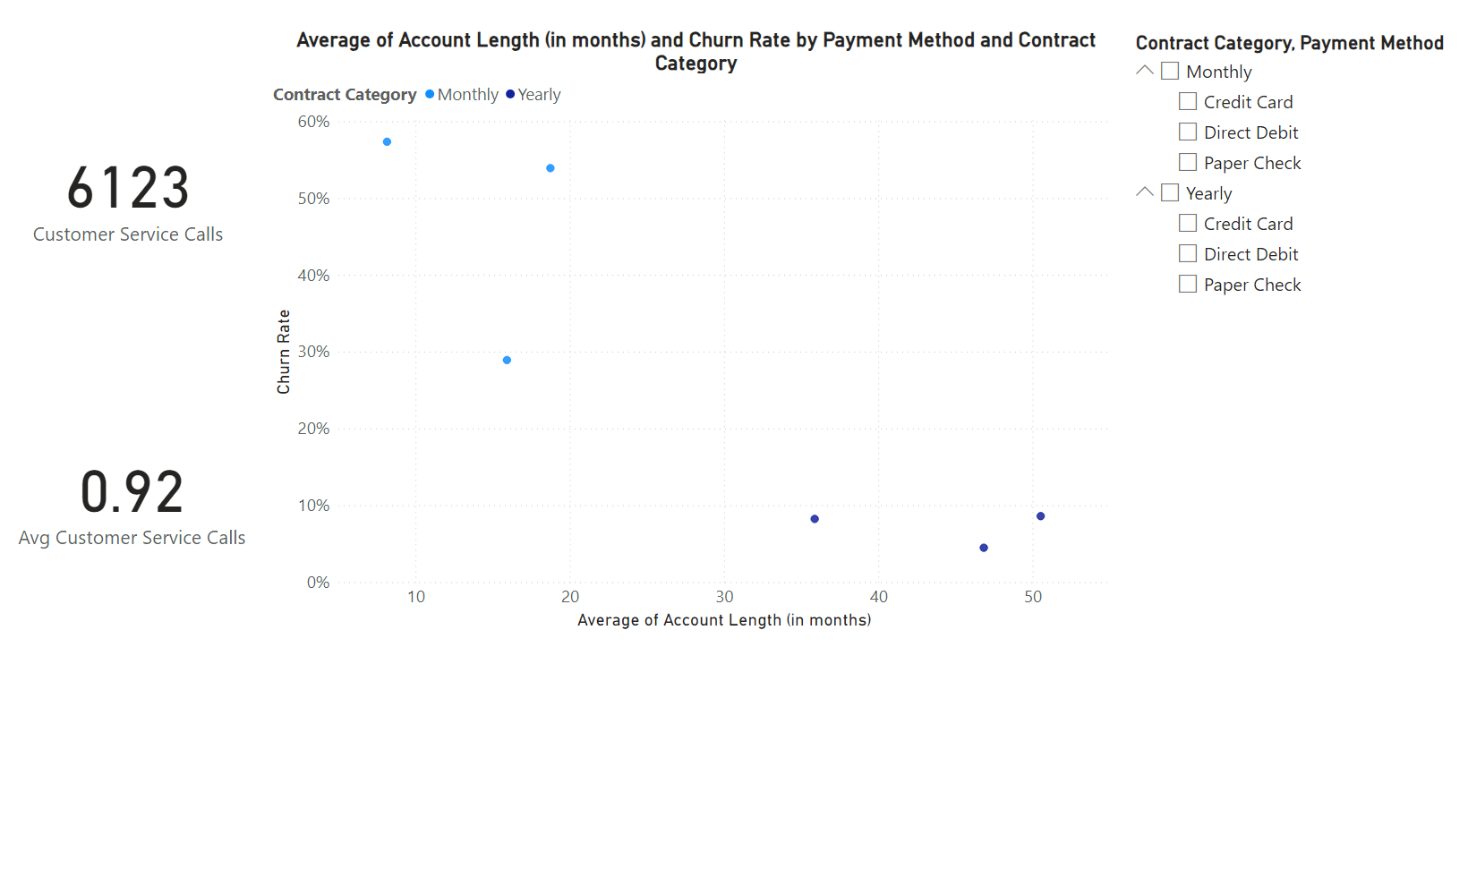
Payment and contract
Notes:
card
No alt text provided
card
No alt text provided
scatterChart
No alt text provided
slicer
No alt text provided

Slide 10
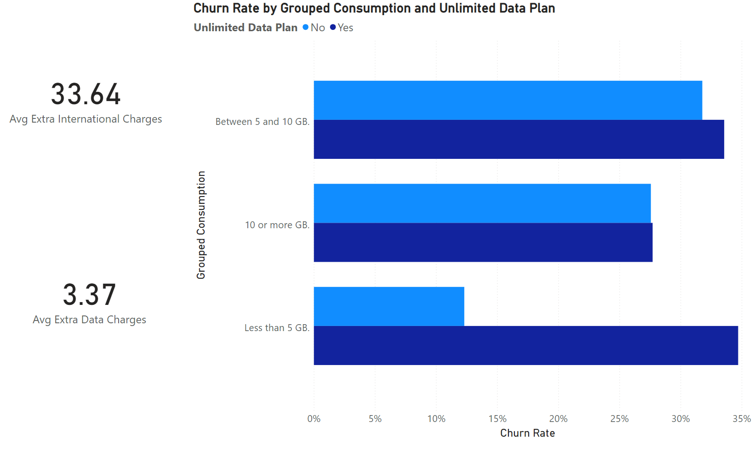
Extra Charges
Notes:
clusteredBarChart
No alt text provided
card
No alt text provided
card
No alt text provided

Slide 11
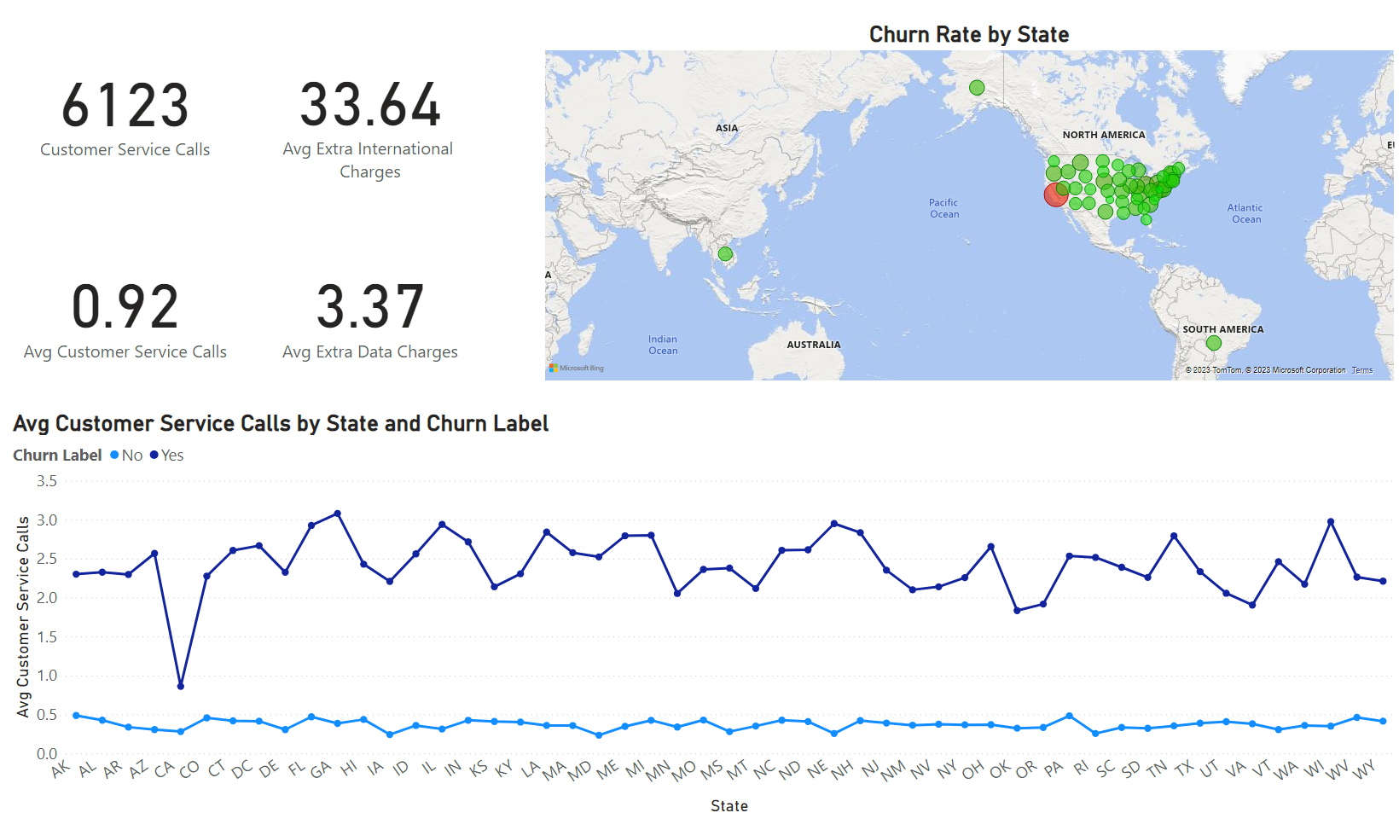
Insights
Notes:
card
No alt text provided
card
No alt text provided
card
No alt text provided
card
No alt text provided
lineChart
No alt text provided
map
No alt text provided

